Slide 1
CAPSTONE PROJECT
Generating Images using GANs
Final Project
Presented By
RAGHUL R
711721244037
III BTech CSBS
KGISL Institute of Technology
3/21/2024 Annual Review

Slide 2
PROJECT TITLE
Generating Realistic Images with GANs(Generative Adversarial Networks) : A Deep Drive into Image Generation Technology
3/21/2024 Annual Review

Slide 3


AGENDA
Problem Statement
Project Overview
End Users
Solution and Value Proposition
The Wow Factor in Your Solution
Modelling
Results
3/21/2024 Annual Review

Slide 4

PROBLEM STATEMENT
Generating realistic images has been a challenging task in computer vision and graphics.
Traditional methods often struggle to capture complex patterns and details in images.
There's a need for a more advanced approach to generate high-quality, diverse images efficiently.

Slide 5
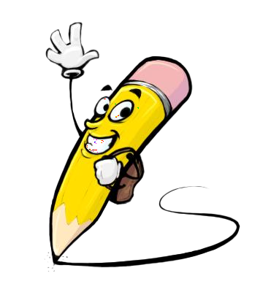
PROJECT OVERVIEW
Our project aims to tackle the challenge of image generation using Generative Adversarial Networks (GANs).
GANs consist of two neural networks, a generator, and a discriminator, which are trained simultaneously.
The generator learns to create images that are indistinguishable from real images, while the discriminator learns to differentiate between real and generated images.
Through adversarial training, GANs improve over time, generating increasingly realistic images.

Slide 6

WHO ARE THE END USERS?
This technology has diverse applications across various industries, including:
Art and design: Generating novel and creative artwork.
Entertainment: Creating realistic scenes and characters for games and movies.
Fashion: Generating new designs and patterns.
Medicine: Generating synthetic medical images for research and training.
3/21/2024 Annual Review

Slide 7

YOUR SOLUTION AND ITS VALUE PROPOSITION
Our solution harnesses the power of GANs to generate high-fidelity images with remarkable realism.
By automating the image generation process, our solution saves time and resources compared to manual creation.
It opens up new possibilities for creative expression and innovation across industries.
The generated images can be customized and tailored to specific needs, enhancing flexibility and adaptability.

Slide 8

THE WOW IN YOUR SOLUTION
Our GAN-based approach produces images that are visually indistinguishable from real ones, surpassing previous methods.
The ability to generate diverse and novel images empowers users to explore new creative horizons.
Our solution offers scalability, allowing for the generation of large volumes of images efficiently.
It can learn from unlabeled data, making it adaptable to various domains and applications.
8

Slide 9
MODELLING
Our GAN architecture consists of a generator network and a discriminator network.
The generator takes random noise as input and produces images, while the discriminator distinguishes between real and generated images.
We employ techniques such as deep convolutional networks and batch normalization to enhance performance and stability.
The training process involves iteratively updating the generator and discriminator networks to improve image quality.
9

Slide 10
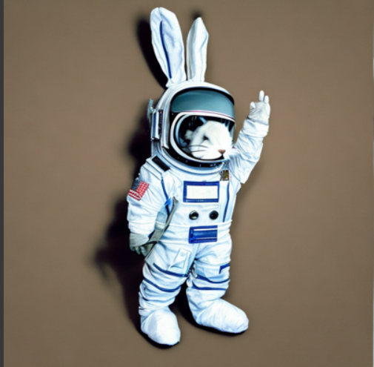
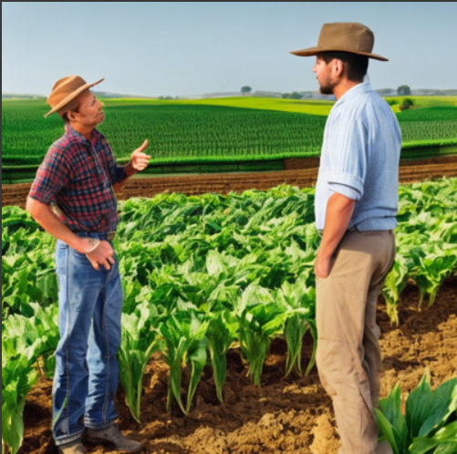
RESULTS
10

